Slide 1
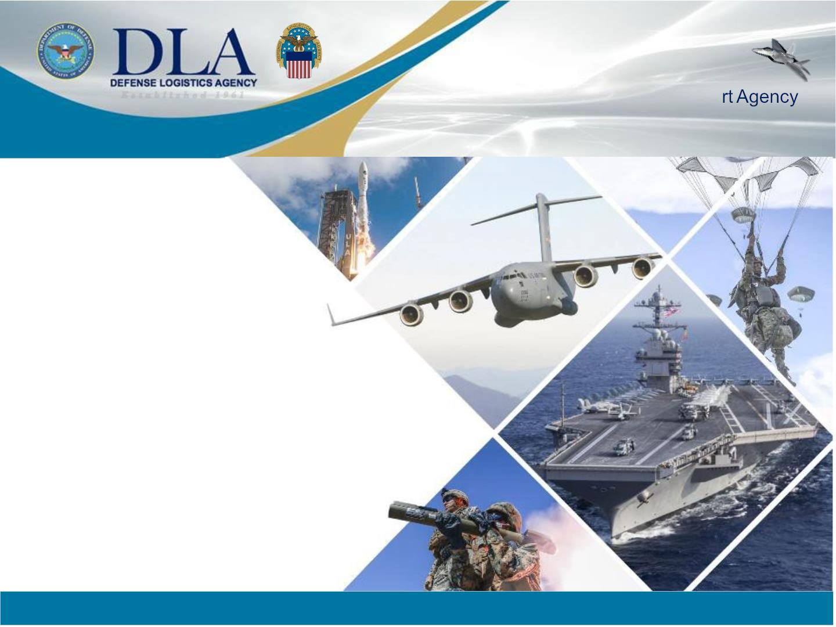
E s t a b l i s h e d 1 9 6 1
The Nation’s Combat Logistics Suppo
DLA: SBA channels,
Emerging requirements,
and R&D
COL Jerry Acosta
10 JAN 24
As of 10 JAN 24
WARFIGHTER ALWAYS

Slide 2

Agenda
• DLA Strategic Plan Lines of Effort and Composition
• DLA Support to CENTCOM and SOCOM
• DLA C&S Middle East Capabilities
• Jump Starting ‘24
• Doing Business with DLA
• DLA Small Business Information
• DLA R&D Page
WARFIGHTER ALWAYS
2

Slide 3
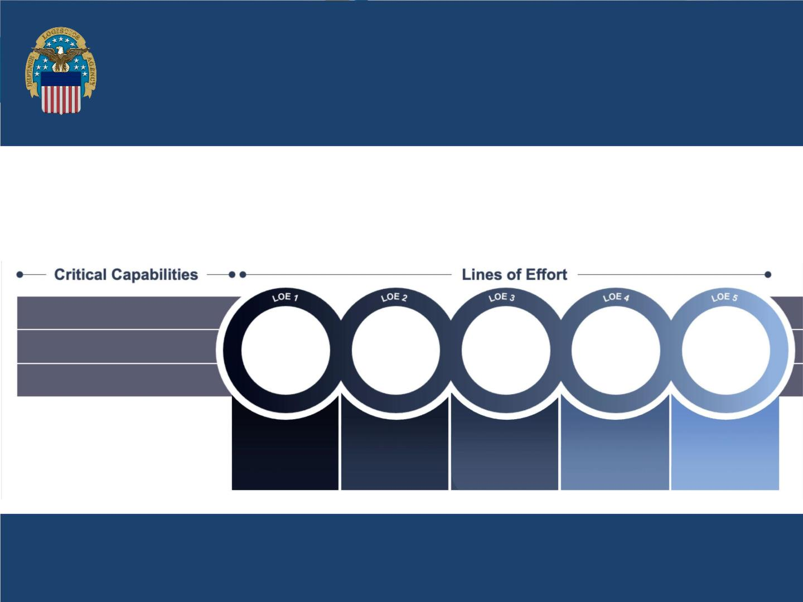
TRANSFORMING GLOBAL LOGISTICS
As the Nation’s Combat Logistics SupportAgency, we must lean forward to address new challenges that
threaten our global environment. We will meet those threats and the evolving needs of the warfighter and
nation with this Strategic Plan, which identifies our most critical priorities and will transform our business
processes over the next five years. Though this transformationwill not encompass all of DLA’s day-to-day
activities, these core objectives will have the greatest impact on our ability to achieve mission success.
MISSION:
VISION:
Deliver readiness and lethality to the Warfighter
Always and support our nation through quality,
proactive global logistics.
As the Nation’s Combat Logistics Support Agency and
valued partner, we are innovative, adaptable, agile, and
accountable – focused on the Warfighter Always.
People & Culture:
Supportingour people
Support
to the
Nation
Trusted
Mission
Partner
Modernized
Acquisition &
SupplyChain
Management
Fiscal Stewardship:
Investing in outcomes
Warfighter
Always
Future
of Work
Digital-Business Transformation:
Embracingthe future
Tailored
solutions to
drive readiness
Deliberate
approach,
without tradeoff to
the warfighter
Transparency &
accountability to
our customers
Leading in
logistics to deliver
best value &
Adapting to
new ways of
working
manage risk
EnterpriseKey Performance Indicators (KPI) measure the success of this strategy:
• Service Readiness
• Supply Availability
• Acquisition Timeliness
• Business Health
• Liquidity
• Customer Satisfaction
• Employee Engagement
• Price Competitiveness
3

Slide 4
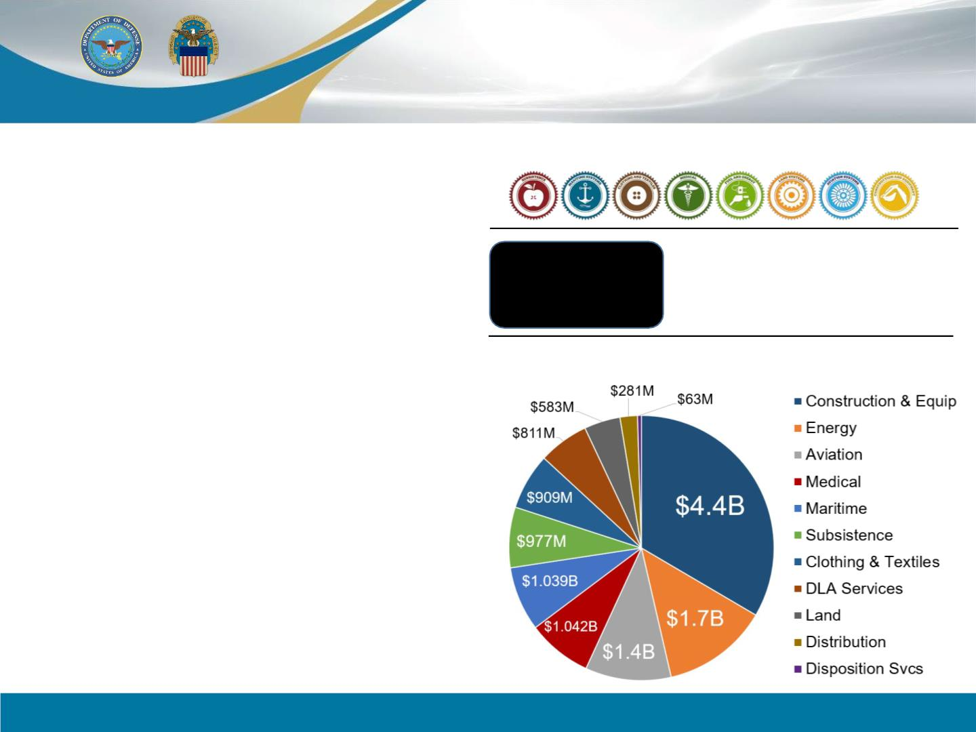
Defense Logistics Agency
6 Major Subordinate Commands
Manages 8 Supply Chains
• DLA AVIATION
Manages the supply chain for aviation weapons systems repair parts,
flight safety equipment, maps, consumable hardware, environmental
products and industrial plant equipment.
About
and provided more than
• DLA TROOP SUPPORT
Manages the supply chains for food, textiles, construction material and
medical supplies and equipment, including pharmaceuticals.
5 million $46.7
Billion
line items
in goods and services for FY2022
• DLA DISPOSITION SERVICES
Disposes of excess property by reutilization, transfer and
demilitarization; conducts environmental disposal and reuse.
Small Business Contracts - FY2022
• DLA LAND AND MARITIME
Manages the supply chain for ground-based and maritime weapons
systems repair parts, consumable hardware, small arms parts and fluid-
handling systems.
• DLA ENERGY
Manages the supply chain for petroleum and lubrication products,
alternative fuel and renewable energy, aerospace energy; provides fuel
quality and technical support, fuel card programs and installation
energy services.
• DLA DISTRIBUTION
Provides storage and distribution solutions and management,
transportation planning and management, logistics planning and
contingency operations; operates a global network of distribution
centers.
WARFIGHTER ALWAYS
4

Slide 5
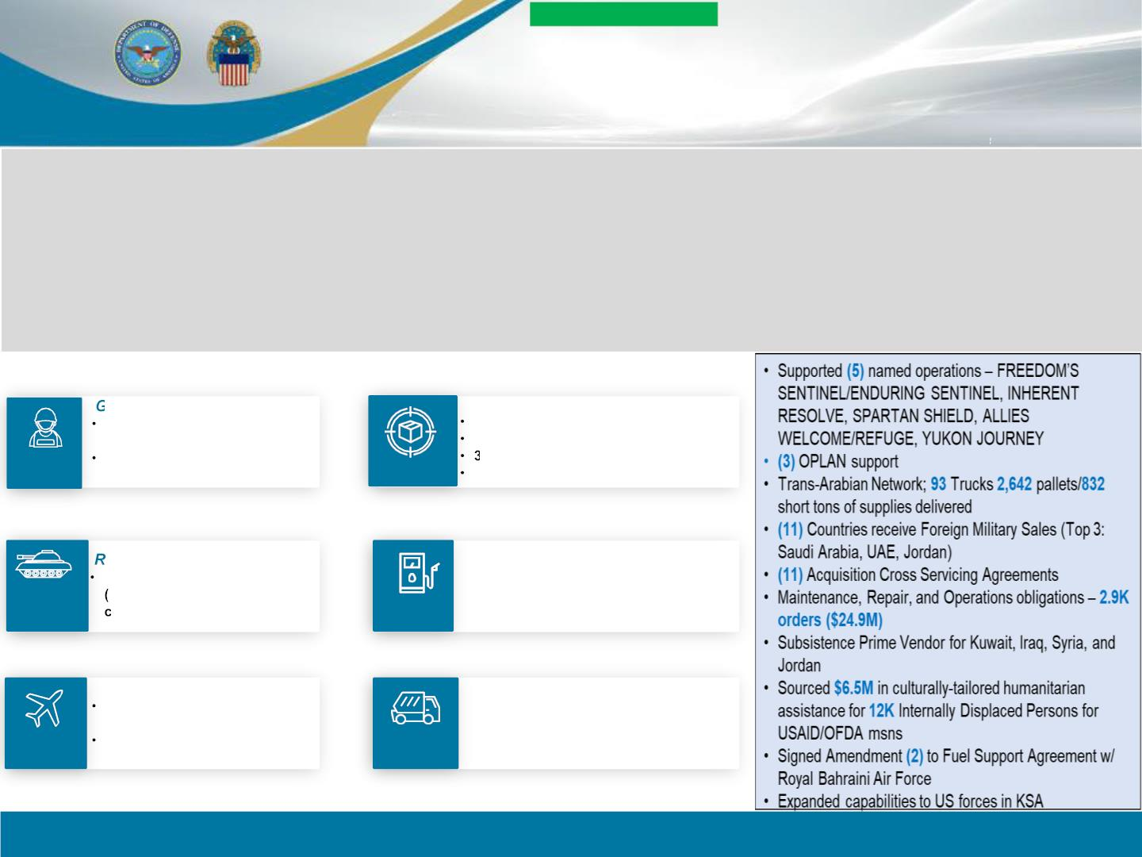
UNCLASSIFIED
DLA Support to
CENTCOM/SOCOM
Mission
• Integrate
• Synchronize
• Sustain the
Warfighter
Vision:
Priorities:
• Integrated with CENTCOM,
SOCOM & Service Components
• Postured to anticipate
requirements
• Enable Operational Readiness
• Sustain the Warfighter
• Strong Partnership
• Unity of Effort
SUPPLY CHAIN SUPPORT
eneral Supply and Services
Class I, OPRATS, Non-
Standard Food Support
Construction, Medical
Supplies, Uniforms
Storage / Distribution Solutions
OCONUS Fwd Stocking
TransportationManagement
4 DistributionCenters / Depots
Expeditionary/Deployable Depot (DDXX)
TROOP
SUPPORT
DISTRIBUTIO
N
epair Parts, Tires, Batteries
Repair parts for ground-based
MRAPs, GMVs), maritime&
ommercial systems
Comprehensive Energy Solutions
• Bulk Petroleum Support
• Fuel Card Program
• Host Nation Fuel Agreements
• Specilized Fuels/Aerospace Energy
LAND &
MARITIME
ENERGY
Repair Parts, Oils, Maps
Repair parts for fixed and
rotary wing aviation systems
Oils and packaged petroleum,
maps, and bottled gases
Disposal Services
• Retrograde Support
• Excess Property Disposal
• Reutilization/Demilitarization
• EnvironmentalDisposal/Reuse
AVIATION
DISPOSITION
SERVICES
WARFIGHTER ALWAYS
6

Slide 6
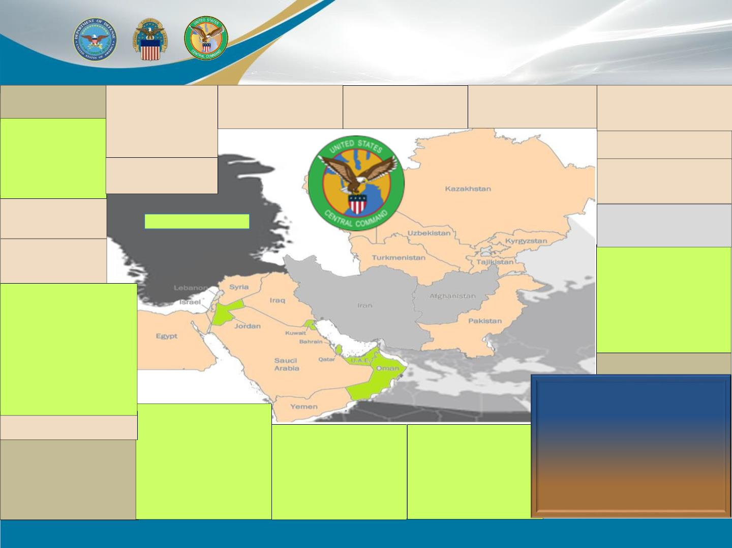
DLA Capabilities in the CENTCOM AOR
Europe(EUCOM)
Iraq
Israel
Kazakhstan
Turkmenistan
Kyrgyzstan
.
.
.
DLA Distribution Europe (DDDE)
DLA Distribution Italy (DDSI)
DLA EUROPE & AFRICA
•
•
•
•
•
•
•
•
(6) Energy Direct Delivery
.
.
.
.
(1) Energy Into Plane
Energy ACSA
(MRO) E&A Prime Vendor
Class I Deliveries (EBREXZONE IV)
.
.
.
.
(MRO) Prime Vendors
DSRCapabilities
Scrapremoval contract (DSDEurope)
(MRO) Prime Vendors
.
.
.
DSRCapabilities
Scrapremoval contract (DSDEurope)
(MRO) Prime Vendors
.
.
.
.
(MRO) Prime Vendors
DSRCapabilities
Scrapremoval contract (DSDEurope)
(MRO) Prime Vendors
(1) Energy Contracted Storage
(1) Energy IntoPlane
(3) Energy Aerospace
(1) Energy Service
(MRO) Prime Vendors
Class I Deliveries
Jordan (2 PAX)
.
.
.
.
.
.
.
.
.
(1) LNO & (1) UCAS (DST-ME)
(1) Energy DFSP (AFCENT)
(MRO) Prime Vendors
(1) Energy Direct Delivery
(3) Energy IntoPlane
(1) Energy Service
DSRCapabilities
Class I Deliveries
HazWasteremoval contract
Uzbekistan
.
.
HazWasteremoval contract
(MRO) Prime Vendors
(1) Scrap removal contract
Syria
Tajikistan
.
.
.
(8) Energy Direct Delivery
(MRO) Prime Vendors
Class I Deliveries VIA T22 (MIL)
.
.
.
.
(1) Energy IntoPlane
DSRCapabilities
Scrapremoval contract (DSDEurope)
(MRO) Prime Vendors
Egypt
.
HazWasteremoval contract (DSD
Europe)
(MRO) Prime Vendors
CL I deliveries (EBREX ZONE IV)
Lebanon
.
.
DLA PERSONNEL BOG
•
•
•
•
(1) Energy IntoPlane
(4) (MRO) Prime Vendors
(1) Energy Direct Delivery
(MRO) Prime Vendors
Saudi Arabia
UAE/ARE (3 PAX)
.
.
.
.
(1) Energy IntoPlane
.
.
.
.
.
.
.
.
.
.
.
.
.
(SPV)CL1Warehouse/Class I Deliveries
CLI COR
DSRCapabilities
HazWasteand Scrapremovalcontracts
Energy QAR
(2) Energy Direct Delivery
(1) Energy Bulk (FSII)
(3) Energy DFSP
(3) Energy IntoPlane
(3) Energy Bunker
(1) Energy Aerospace
(3) Energy Service
(MRO) Prime Vendors
DSRCapabilities
Class I Deliveries
Bahrain (53 PAX)
.
.
.
.
.
.
.
.
.
.
.
.
.
.
.
.
DLA Energy Middle East HQ
(SPV) CL I Warehouse/Class I Deliveries
Mapping Agency
(WSR)
(1) CLI COR
(2) Disposal ServiceFieldOffice
HazWaste and Scrap removal contracts
DLA Distribution Bahrain (DDNB)
(4) EnergyDirect Delivery
(1) EnergyStorage/DFSP
(1) EnergyDFSPviaFSA(NAVCENTStorage)
(1) EnergyIntoPlane
(MRO) Prime Vendors
Seychelles (PACOM)
. (1) Bunker fuelcontract
(1) EnergyBunker
(2) EnergyAerospace
IndustrialGasWarehouse
(MRO) Prime Vendors
Major Logistics / Sustainment Capabilities:
Pakistan
.
.
Kuwait (92 PAX)
•
•
•
•
•
•
•
•
•
.
Defense Fuel Support Points (DFSPs)
Direct Delivery Sites
Into Plane Contracts
Warehousing/Class IV/Class IX/Maps
Subsistence Prime Vendor (SPV)
Maintenance, Repair and Operations (MRO)
Fresh Fruits and Vegetables (FF&V)
Local Market Ready (LMR) Bread, Dairy
Bottled Water
(MRO) Prime Vendors
(1) Energy IntoPlane
.
.
.
.
.
.
.
.
.
.
.
.
.
.
(16) DLA Support Team(DST-ME)
(SPV) CL I Warehouse/Class I Deliveries
(1) CL I COR
Qatar (33 PAX)
Oman (1 PAX)
Djibouti(AFRICOM)
(8) DSD-CHQ Office
.
.
.
.
.
.
.
.
.
.
(SPV) CL I Warehouse/Class I Deliveries
(6)Disposal Service FieldSite
Scrapremoval contracts
(1) Energy Direct Delivery
(1) Energy Bulk
(2) Energy DFSP
(1) Energy Plane
(1) Energy Aerospace
(1) Energy Service
(MRO) Prime Vendors
.
.
.
.
.
.
.
.
(1) Energy DFSP
(3) Energy DFSP via FSA (RAFO Storage)
(1) Energy IntoPlane
(1) Energy Bunker
DSRCapabilities
HazWasteRemoval Contract
Class I Deliveries
(MRO) Prime Vendors
.
.
.
IndustrialGasWarehouse
(1)Into-Plane fuelcontract
(SPV) CL I Warehouse/Class I Deliveries
Capabilities
(22) Full-ServiceDisposition Service Yard
HazWasteand Scrap removal contracts
IndustrialGasWarehouse
Tire PVWarehouse
(2) Energy DFSP Bulk
(1) Energy DFSP (ARCENT Storage)
(1) Energy IntoPlane
(3) Energy Aerospace
(2) Energy Service
(MRO) Prime Vendors
.
.
.
.
.
(WSR)
(2)Disposal Service FieldOffice
HazWasteand Scrapremovalcontracts
(MRO) Prime Vendors
Disposition Services Sites Kuwait/Qatar
(1) Energy DFSP
Source: DLA CENTCOM and SOCOM
As of 30 JAN 2023
WARFIGHTER ALWAYS
7

Slide 7
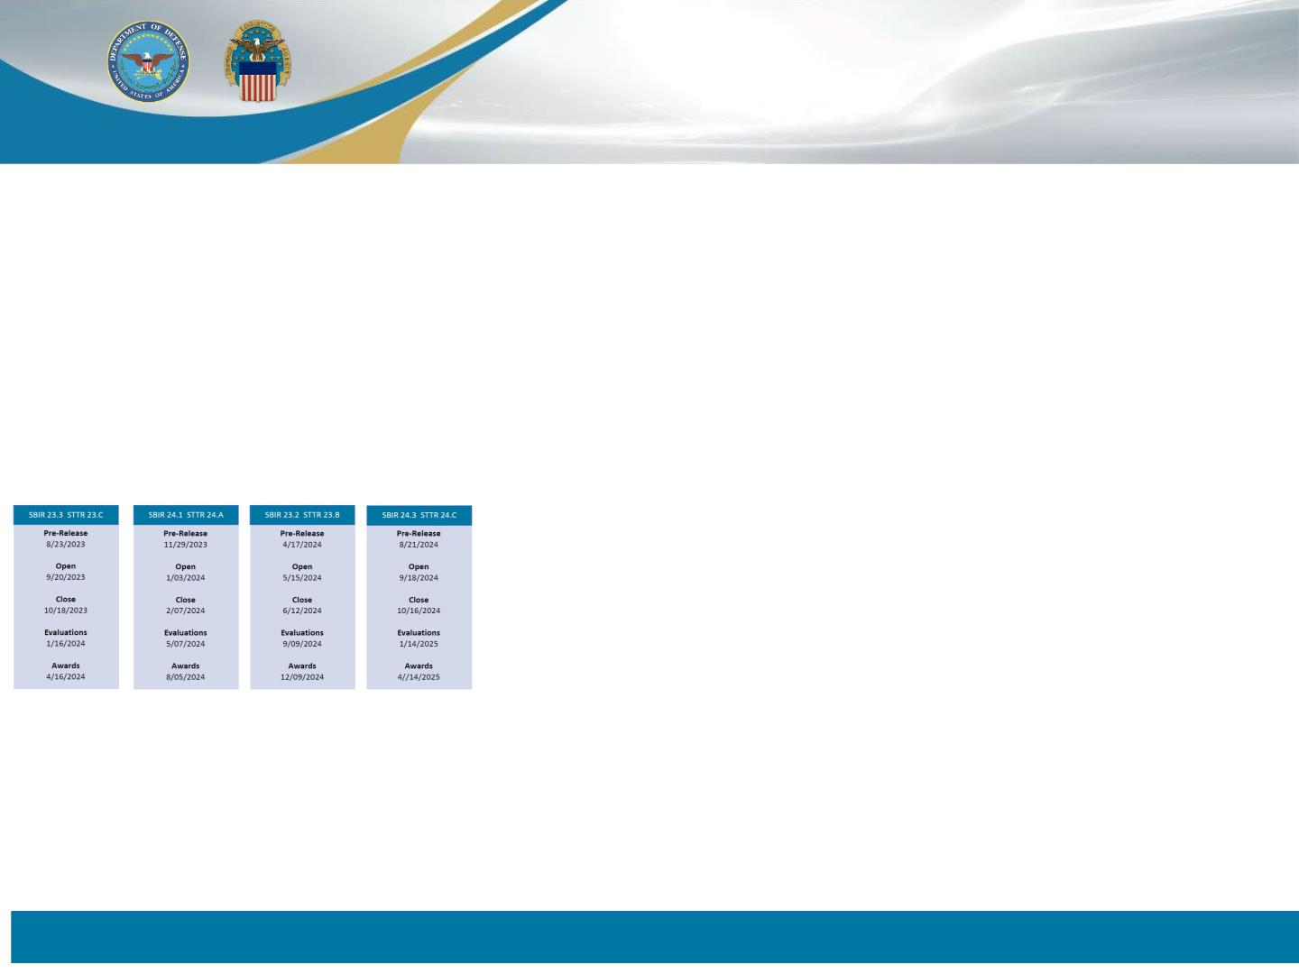
Jump Starting ‘24
DOD Key Announcements
• FY24 Appropriations Bill: $141M above the PB to continue implementing the National Security
Commission of AI recommendations; Accelerates Chief Digital Officer’s priorities.
• NDAA has increased the SDVOSB contracting goal to 5% (from 3%).
• SEC’s new requirement for public companies to disclose material cyber security incidents
• DOD’s Cybersecurity Maturity Model Certification Four-Phase roll-out: CMMC Model (defense.gov)
• SBIR Schedule:
DOD Innovation Trends
• Digital Transformation: Review the NOV 23, DOD Data, Analytics, and AI Adoption Strategy
• Rapid Prototyping: Review the Rapid Defense Experimentation Reserve Initiative (RDER)
• Quantum, Hypersonic, and Space were allocated $33 billion budget for space command operations
WARFIGHTER ALWAYS
4

Slide 8
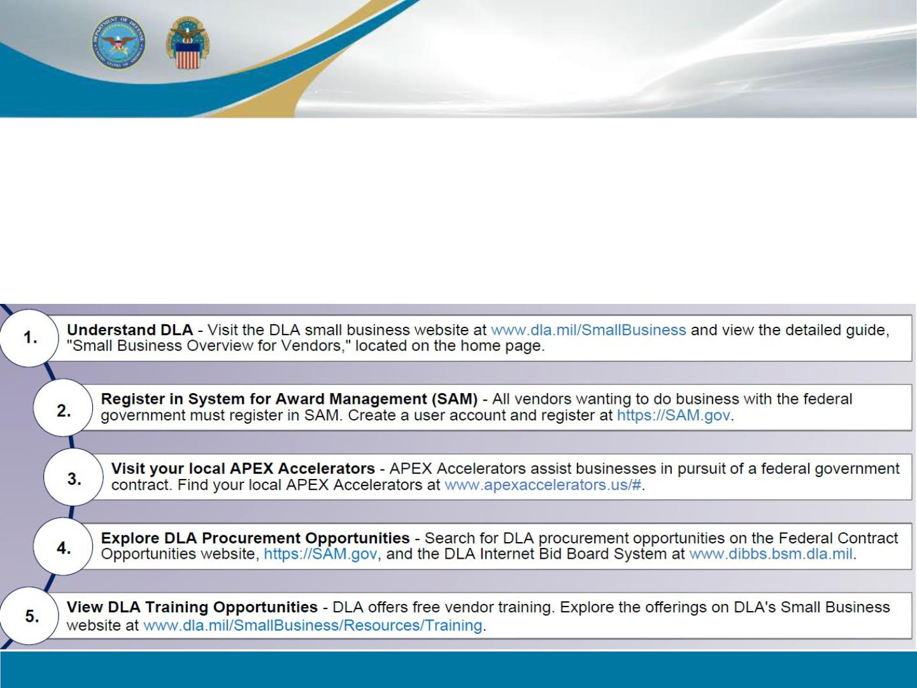
Doing Business with DLA
The DLA Office of Small Business Programs (OSBP) provides training, guidance,
and strategies that maximize opportunities for small businesses so they can
participate in DLA's acquisition program. OSBPs are located at each DLA procuring
activity. They advise and assist contracting, program managers, and requirements
personnel on matters affecting small firms. Companies interested in doing
business with DLA should:
WARFIGHTER ALWAYS

Slide 9
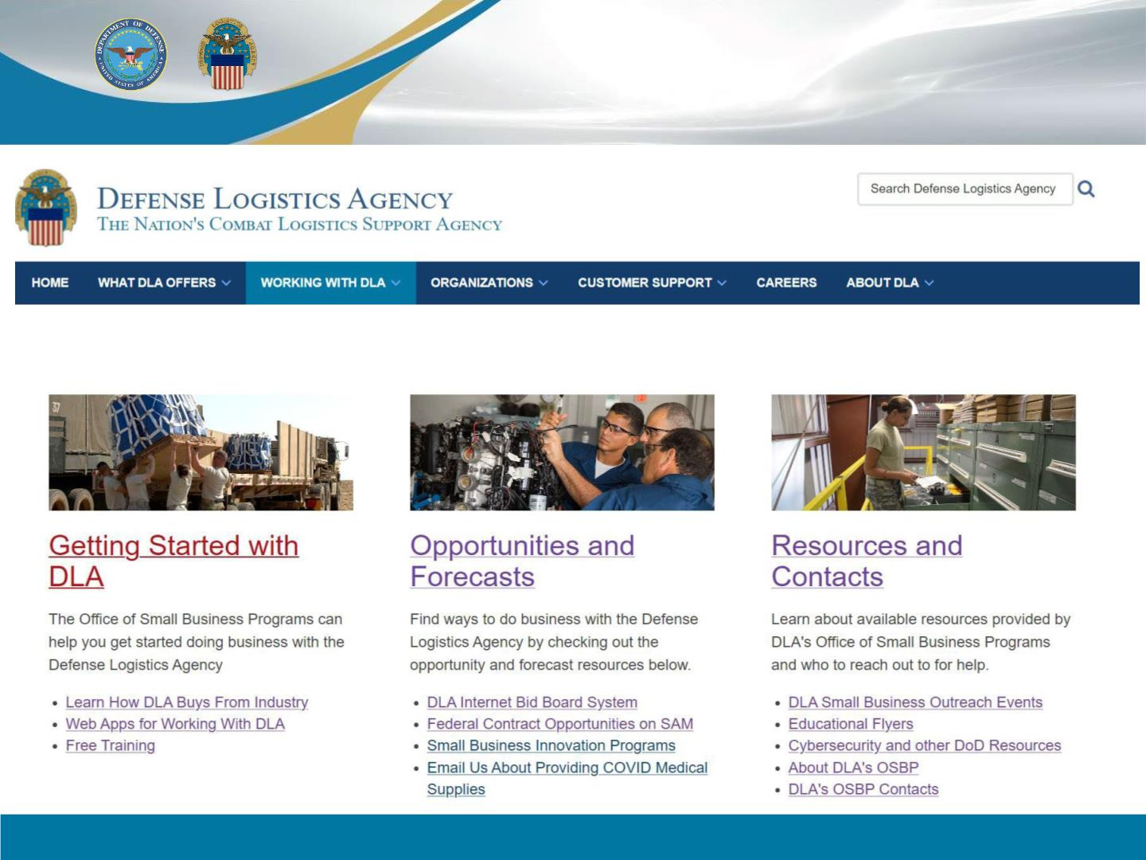
www.dla.mil/SmallBusiness/
DLA Office of Small Business Programs
WARFIGHTER ALWAYS
9

Slide 10
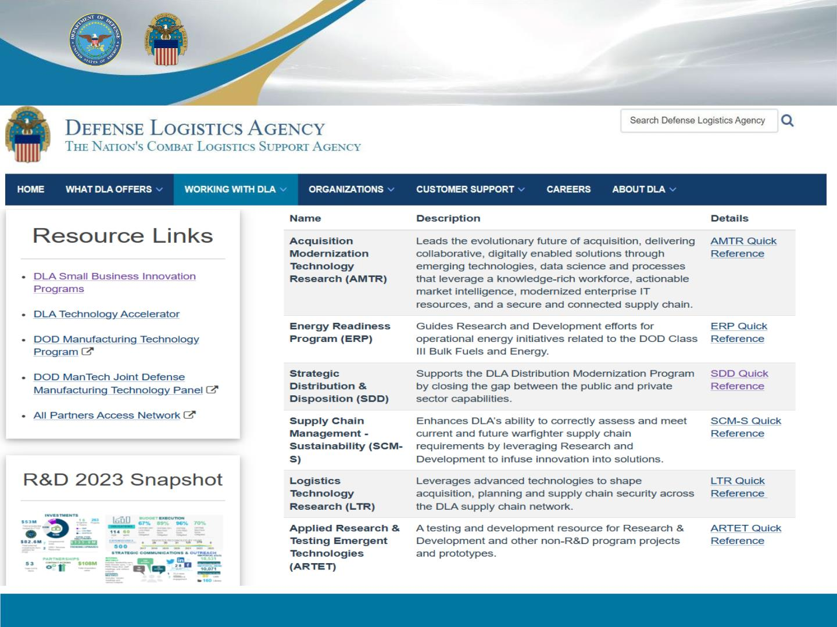
DLA Research and Development
Logistics.Research@dla.mil
WARFIGHTER ALWAYS
9

Slide 11
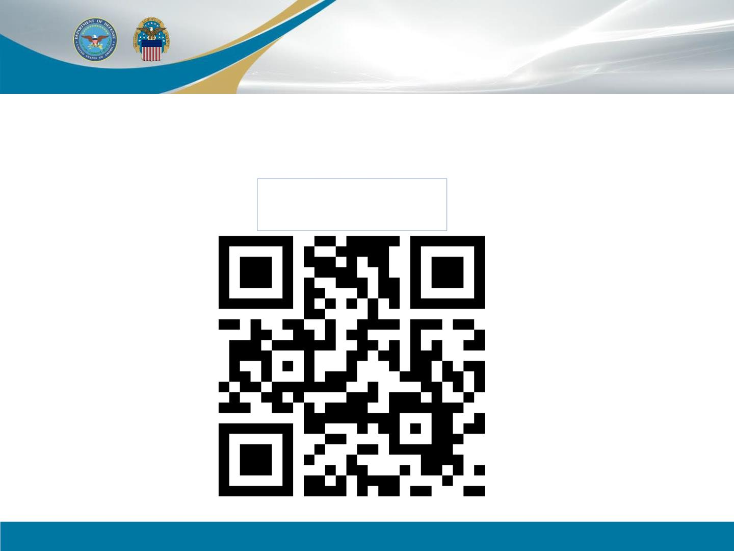
Questions
*Due-Out: Will send the
updated “Who’s Who in DLA”
after final Senate Confirmations
COL Jerry Acosta
LinkedIn
WARFIGHTER ALWAYS
10

