Slide 1
Overview of Assisted Acquisition Services
June 2023
Region 4 Assisted Acquisition Services Division

Slide 2
GSA Mission Statement
“The mission of GSA is to deliver the best value in real estate, acquisition, and technology services to government and the American people.”
We are a full service, contracting office, we can buy any service or commodity a clients needs, EXCEPT construction services, weapon systems/explosives, and architect/engineering services (A&E).

Slide 3
GSA Mission Statement
“The mission of GSA is to deliver the best value in real estate, acquisition, and technology services to government and the American people.”
Agile Organization
  Streamlined processes and dedicated acquisition team
Innovative and Flexible Solutions
  Customize acquisition solutions
Savings
  Proven track record of saving time and money
Understanding Your Needs
  Continuous Process Improvement Requirements

Slide 4
Region 4 AASD
Wayne Masters, Director
Garett Nelson (Acting), Deputy Director
Branch A
Garett Nelson
Branch B
Kelly Clark
Branch C
Fred Tingle
Section1
Markesha McCants
Section 4
Joyce Mayberry
Section 7
Sonia Hammons
Section 2
Frankie McSweeney
Section 5
Crystal Crawford
Section 8
Beth Clark
Section 3
Ryan Byrd
Section 6
Tony Roy
Section 9
Dan Jenkins

Slide 5
AAS Process Overview
Sign Interagency Agreement
&
Accept Funding
Develop Requirements
&
Conduct Market Research
Develop Acquisition Strategy
Conduct Procurement
Administration
&
Performance and Financial Management
Closeout
Closely Collaborating with the Customer at Every Step…
Notes:
13

Slide 6

Pre-Award Services
  Works directly with the Customer Agency
  Signs the Interagency Agreement
  Performs Requirements Analysis
  Conducts/ Assists with Market Research
  Help Write Statements of Work
  Assists in/Develops Independent Government Cost Estimate

Slide 7

Pre-Award Services
  Develops Acquisition Strategy and Options
  Develops Acquisition Plan/Issue RFI’s
  Prepares Request for Proposal (RFP)
  Issues Solicitation
  Conducts Acquisition
  Ensures utilization of performance-based
  contracting and other stream-lined
  procurement techniques
  Reviews and evaluates proposals
  Provides Legal Support, if necessary

Slide 8

Post Award Services
  COR Support (obtaining Secret and Top Secret clearances)
  Track deliverables against the timeline
  Manage milestones, schedules, and monitors costs
  Monitor the Industry Partner’s performance (CPAR)
  Accept, review and approve invoices
  Perform problem resolution
  Chair progress reviews
  Handle contract close-out

Slide 9
Agile Organization
Regional Head of Contracting Activity Control
  Approval authority for large/complex acquisition plans, extended T&M usage, multi-year contracting, various performance incentives, etc.
  Streamlined Acquisition Processes, Tools and Controls
  Electronic Contracting Systems and Financial Management (ASSIST 2.0))
  Electronic Project Management (Google Plus, WebEX, etc.)
  Experienced Acquisition Workforce
  Dedicated Acquisition Team – Customer Focused
  Contracting Officer, (unlimited warrant) Contract Specialist, Financial Manager, Small Business Specialist, Legal Counsel, Competition Advocate
  Reach-out Capability for Additional Capacity

Slide 10






Innovative and Flexible Solutions
Customer Focused…
Customized Acquisition Solutions
  We don’t put you into a box
  The “right” acquisition is the one that works for you!
  Expertise Acquiring Full Suite of Professional Services
  Information Technology Services, Professional Management Services, Engineering Services, Logistics, Consulting Services (which includes continuous process improvement), Energy, Environmental, Financial, etc.
No Restrictions on Contract Vehicles
  Schedules, GWACs, BPAs, IDIQs, MAC’s, Open Market, Other Agency-Wide Contracts (ASTRO DPA holder) (SBIR3 Pilot Program)

Slide 11
Innovative and Flexible Solutions
No Restrictions on Contract Types or Dollar Value
  FFP, T&M or LH, Cost, Hybrids (What makes sense?)
  Focused on Streamlining Acquisitions
  Interview Style Oral Evaluations
  Multi-Phased Procurements
  Cradle-to-Grave Support
  From award, kick-off, administration to closeout
  Respond to protests, claims and contract FOIAs

Slide 12
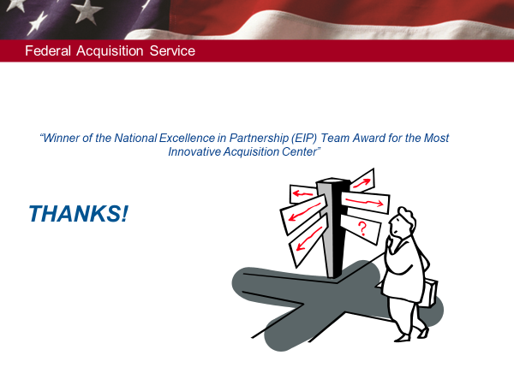
Agency Seals

